Slide 1

Report optimization tips

Slide 2
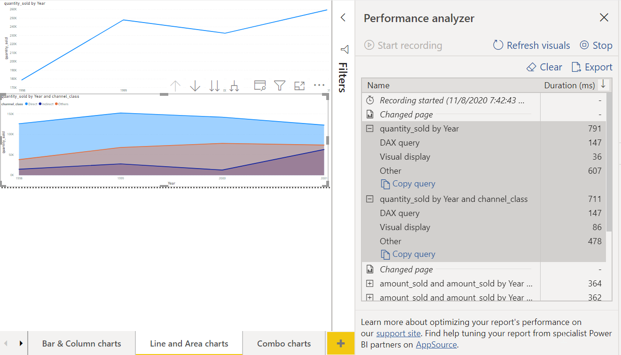
Tools: Performance analyzer (Power BI Desktop)
In Power BI Desktop you can find out how each of your report elements, such as visuals and DAX formulas, are performing. Using the Performance Analyzer, you can see and record logs that measure how each of your report elements performs when users interact with them, and which aspects of their performance are most (or least) resource intensive.

Slide 3
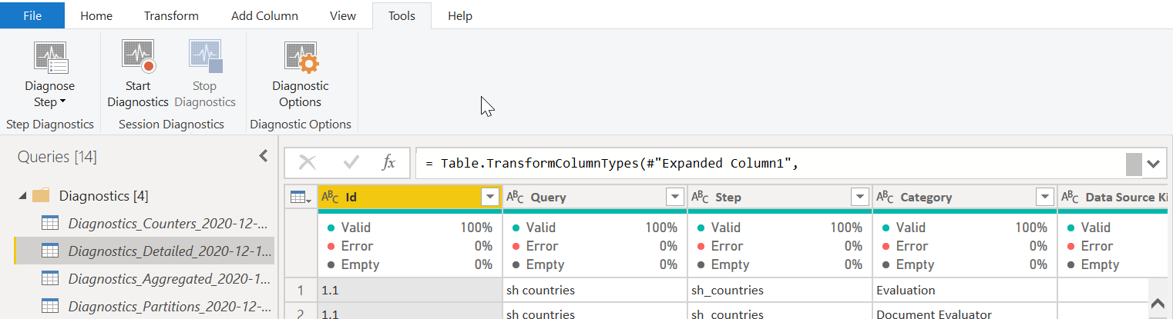
Tools: Query diagnostics
To access query diagnostics in Power Query Editor, go to Tools in the Home ribbon. When you are ready to begin transforming your data or making other edits in Power Query Editor, select Start Diagnostics on the Session Diagnostics tab. When you are finished, make sure that you select Stop Diagnostics.
This tool is useful when you want to analyze performance on the Power Query side for tasks such as loading datasets, running data refreshes, or running other transformative tasks.

Slide 4
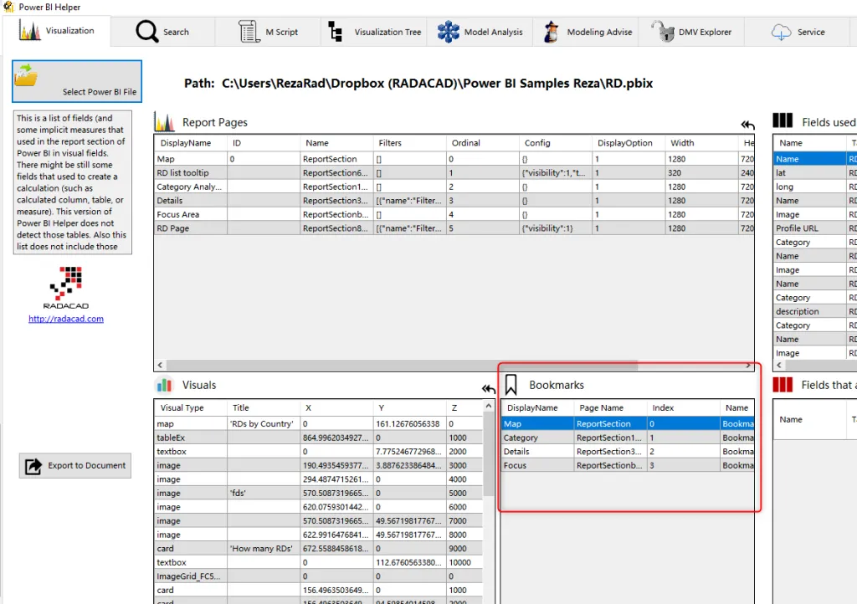
Tools: Power BI Helper
Power BI Helper is a free tool that helps developer to fine-tune the report. It is very powerful tool which also help with report documentation.
Main features are:
List of used/unused field and tables
Pages and visualizations information and metadata
Compare tool (allows to compare two .pbix files)
Export to document (exports documentation)
Dependency tree/ reverse dependency tree
Relationship Metadata

Slide 5
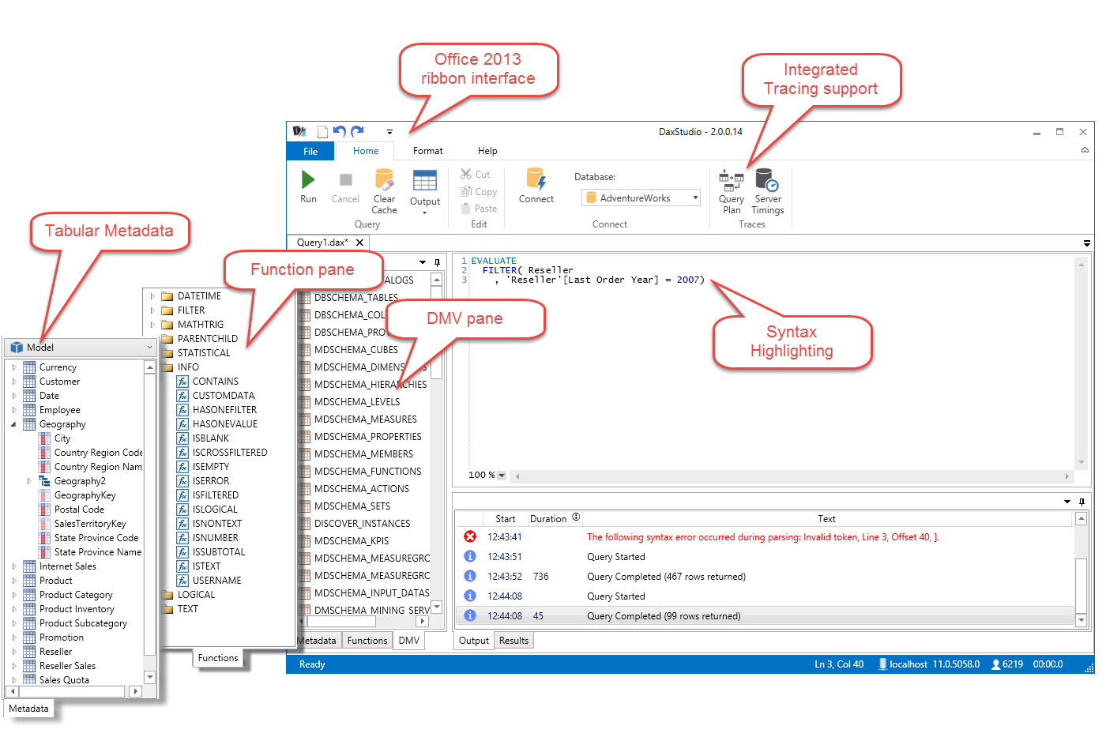
Tools: DAX Studio
DAX Studio is the ultimate tool for executing and analyzing DAX queries against Microsoft Tabular models.
Using DAX Studio user can connect to Power BI data model, execute queries, see model metadata, metrics, etc.

Slide 6
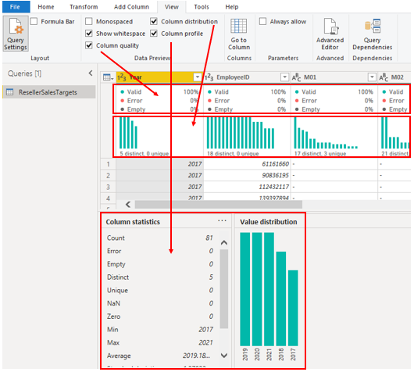
Optimization tips
Get rid of not used tables, fields, especially date and date/time fields.
Set proper data types, query names.
Use column details to get information about quality, distribution and profile.
Get rid of not used calculations, but don’t forget to trace dependences!
Review calculations, maybe there’s a way to simplify it or prepare data during data transformation steps.
Review visualizations – too many visualizations on the page may affect page performance. For example, each slicer on the page could be moved to the Filter Pane.

Slide 7
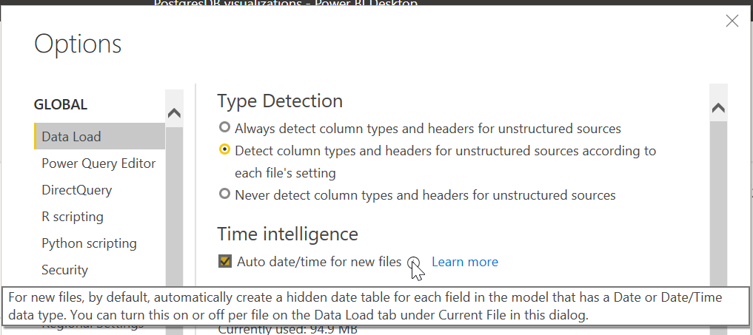
Optimization tips
Disable “Auto date/time for new files” feature if possible.
Process as much data as possible in the original data source.
Use native SQL queries. When using DirectQuery for SQL databases, make sure that you are not pulling data from stored procedures or common table expressions (CTEs).
Separate date and time, if bound together. If any of your tables have columns that combine date and time, make sure that you separate them into distinct columns before importing them into Power BI. This approach will increase compression abilities.
Power BI has pre-build performance report for the whole capacity. It’s available for Power BI Admins in the Service. It’s very helpful to evaluate overall capacity performance and retrieve metadata for each report.
More on Microsoft Docs

